Slide 1


“Brothers, Stop Da Talk and Walk Da Walk, It All Matters”
9th Episcopal District of the AME Church
6th Annual Men of Valor Conference
Presenter:
Rev. Ronald D. Sterling, D. Min., Pastor
Saint Paul AME Church, Smithfield
Rev. Dr. John Campbell & Bro. Robert Turner,
Sons of Allen District Coordinators
Bishop James L. Davis, Presiding Prelate

Slide 2
The AME Church
The Mission
  To minister to the social, spiritual, and physical development of all people.
The Vision
  At every level of the Connection and in every local church, the AME Church shall engage in carrying out the spirit of the original Free African Society, out of which the AME Church evolved: that is, to seek out and save the lost, and to serve the needy. It is also the duty of the Church to continue to encourage all members to become involved in all aspects of church training.

Slide 3
Primary Objectives of
Church Evangelism
Go Make Disciples (Mt 28:19)
  Of all nations,
  Baptize them
Sent by Jesus (Jn 20:21)
  As the Father has sent me, even so I am sending you
Receive Power (Acts 1:8)
  Be witnesses in Jerusalem and in all Judea and Samaria, and to the end of the earth

Slide 4
Relational
Vertical Relationship with the Lord
  “Love the Lord your God with all your heart and with all your soul and with all your strength and with all your mind” (Lk 10:27).
  “Serious ministry, says Dr. Lyle Dorsett, requires that one
      Go deep with the Lord;
      Be radical about your calling;
      Spend time in solitude with the Lord;
      Be in the Word.” ¹
1. Lyle W. Dorsett, Billy Graham Professor of Evangelism, Beeson Divinity School at Samford University , Interview by Ronald D. Sterling, November 29, 2005)

Slide 5
Relational
Vertical Relationship with the Lordcont…
  Be a “living testimony” of God’s grace and mercy
    “When they saw the boldness of Peter and John…they recognized that they had been with Jesus” (Acts 4:13).
    “No longer conformed to the ways of the world, but transformed through the renewing of the mind” (Rom 12:2).
Horizontal Relationship with Others
  “And, love your neighbor as yourself” (Lk 10:27)
  “I was naked and you clothed me, I was sick and you visited me, I was in prison and you came to me” (Mt 25:36).
  Hospitable “love of strangers” Those who are not like us
  (1 Tim 3:2, Tit 1:8)

Slide 6
Relational
Heart for Those Outside the Will of God
  Prayer
    “The harvest is plentiful but the laborers are few” (Mt 10:37).
      Nonbelievers are lost.
      Some believers have lost their way.
  Brokenness
    Divine plan of salvation
      God’s love for humanity (Jn 3:16; Rom 5:8; 2 Cor 5:19, Rom 3:23)
    Personal brokenness within the faith community
      Your personal testimony of God’s transforming power (2 Cor 5:17)
      God uses “our misery and turns it into ministry” (Sterling, 2006).
      Reach back and help others (Lk 22:32).

Slide 7
Disciples of Christ
Contemporary Definition
  A Christian disciple, according to Michael J. Wilkins, is “One who has come to Jesus for eternal life, has claimed him as Savior and God, and has embarked upon the life of following him.”
Chosen Vessels
  All believers (Jn 3:7)
  Gifted Individuals (Eph 4:11)
Spirit-empowered
  “You shall receive power after you have received the Holy Ghost and you shall be witnesses…” (Acts 1:8; 4:33)
2

Slide 8
The Where of Evangelism (Acts 1:8)
Jerusalem
  Evangelism starts in the home and the church.
  The Gospel can spread as a result of persecution in your Jerusalem (Acts 8:1).
Judea - Samaria
  Result of persecution at Jerusalem
  Occurred in surrounding communities (Acts 8:4; 10:37)
  Not by the twelve, but through Philip the evangelist (Acts 8:5)
Uttermost Part of the Earth
  People of different ethnicities (Acts 9:15; 13:47)
  Paul was sent to the Gentiles (Acts 9:4-19).

Slide 9
Getting Out of the Boat
At Whose Word?
  At the bidding of the Lord (Mt 14:28)
When?
  At His direction (Mt 14:29)
Where?
  Wherever He leads (Mt 14:29)

Slide 10
Getting Out of the Boat
Requirements?
  Effectual and Fervent Prayer
    The prayers of the righteous avails much power (Jas 5:16).
    We must pray without ceasing (1 Thes 5:17).
  “Crisis of Belief”
    A God-sized outcome requires a God-sized faith.
    We must cast aside doubt and unbelief (Mk 11:22-24).
  Faith
    Without faith, it is impossible to please God (Heb 11:6).
    Fully persuaded through faith and patience (Heb 6:12)
Outcome?
  Trust the Lord to give the increase
  Continue to stand against the enemy (Eph 6:13).
3
3. Henry Blackaby, Richard Blackaby, and Claude King, Experiencing God: Knowing and Doing the Will of God (Nashville: Life Way Press, 2007), 132.

Slide 11
Getting Out of the Boat
Obstacles
  Lack of empowerment
  Lack of passion
  Fear of man
  Fear of rejection
  Insecurity
  Not sure how to communicate your “story”

Slide 12
Getting Out of the Boat
How to Overcome Obstacles
  Recognize that witnessing is a work of the Spirit, not of the flesh (Zech 4:6, Acts 1:8).
  Be filled with the Spirit (Eph 5:18).
  Search Scriptures for meditation and memorization (2 Tim 1:7; Josh 1:8).
  Ask God for a heart of compassion (Mt 9:36).
  Know God’s strength is manifested in weakness (2 Cor 12:9).
  Role play with others and keep telling your story.

Slide 13

Toiled All Night—Still No Catch!
We’ve done all that we know to do!
What now, where’s the harvest?

Slide 14
Launch Out into the Deep…
Launch out into the deep???
“…Launch out into the deep, and let down your nets for a draught.” Luke 5:4

Slide 15
Launch Out into the Deep
The Line Has Been Cast
  One plants, one waters, and God gives the increase (1 Cor 3:6).
  Continue to walk by faith, not by sight (1 Cor 5:7).
  Start praising the Lord for the harvest.
Trust the Lord
  Lean not to your own understanding (Prv 3:4-6).
  God’s ways are not our ways (Is 55:8).
  The Lord adds to the church (Acts 2:47).

Slide 16
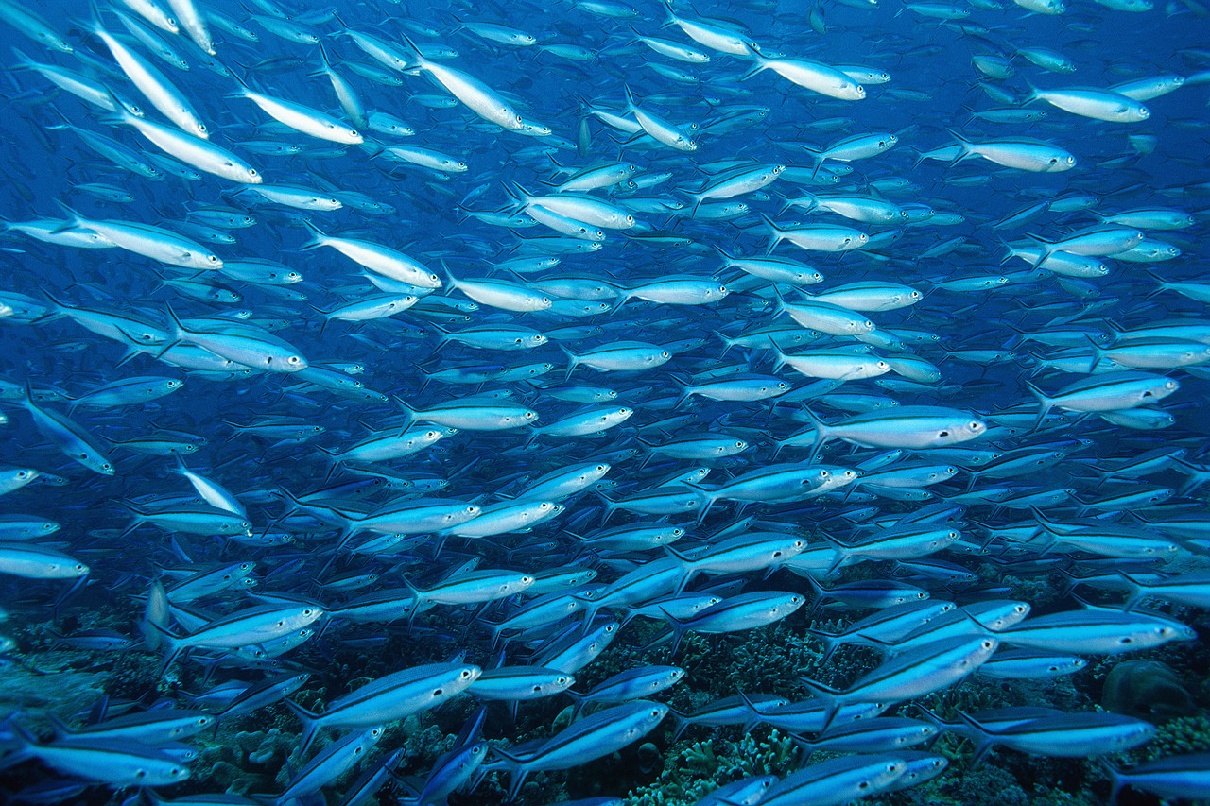
Launch Out into the Deep
“God has spoken, so let the Church say Amen!”

Slide 17
Questions & Answers
Thank you for your attention and participation!

